Slide 1
BANA-212 Final Project: Used Car Analysis
Group 22: William Leonard, Susan Mikhail, Matthias Ronnau, Lokesh Nandni Sood, Parsa Tahmasebi

Slide 2

Agenda
Project Overview
The Data
Analysis
Results

Slide 3
Project Overview

Slide 4


Market Overview
According to CNBC, “The used car boom is one of the hottest, and trickiest, coronavirus markets for consumers”
Covid-19 car buyers are more sensitive to auto cost and want to avoid mass transportation increase in used car sales
New cars are becoming more expensive, so people are turning to used cars

Slide 5


Project Overview
Use data on Craigslist used car listings to build a predictive model that predicts the price point of a used car given several features about the car
With lots of different opinions out there on what cars are worth, it can be difficult to properly price a car that you wish to sell

Slide 6
The Data

Slide 7
The Data
Original dataset had 25 columns and 423,857 rows
Columns contained information in the listing such as the manufacturer, the car’s condition, what type of fuel the car used, the mileage on the odometer, and the listing price (our dependent variable)

Slide 8
Data Cleaning
Drop variables that wouldn’t help in analysis (“id”, “url”, “region”, etc.)
Use regex to strip the integer from the “cylinders” column:
“8 cylinders” 8, “4 cylinders” 4, etc.
Drop the “size” column as over 75% of the values are missing
After all data cleaning remove rows with missing values
About 76%, but still left with almost 100,000 rows

Slide 9
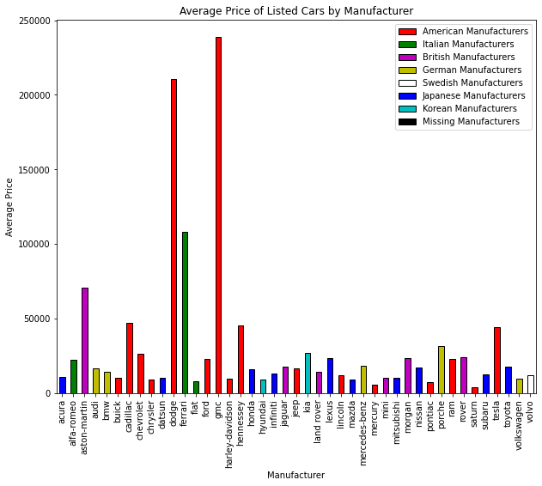
Data Cleaning, Cont.
Extreme and erroneous variables in “price” columns
Dodge and GMC, which are not known to be "high end" vehicles, show a mean price that is larger than luxury brands like Aston-Martin and Ferrari
Use info in listing to impute correct price listing, remove others without correct info
Remove any value of a car priced over $300,000 or below $100

Slide 10

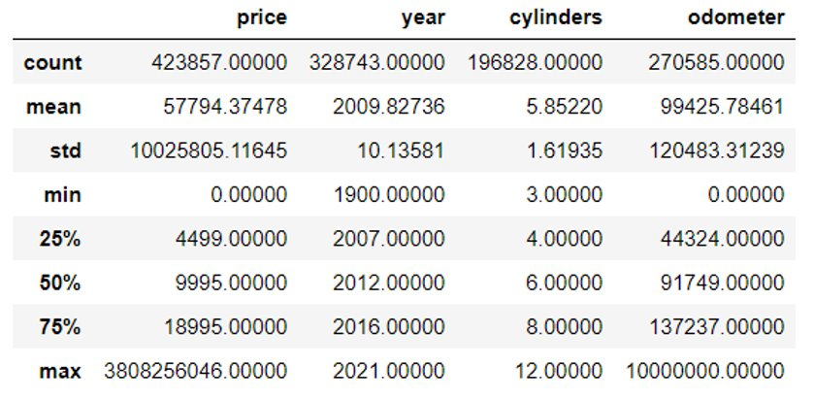
Data Cleaning, Cont.
Extreme and erroneous variables in “odometer” columns
According to Car and Driver, the average American drives 13,500 miles per year
Remove any value for “odometer” over 999,999 and fill with min(999,999, (car age * 13,500))

Slide 11
Analysis

Slide 12
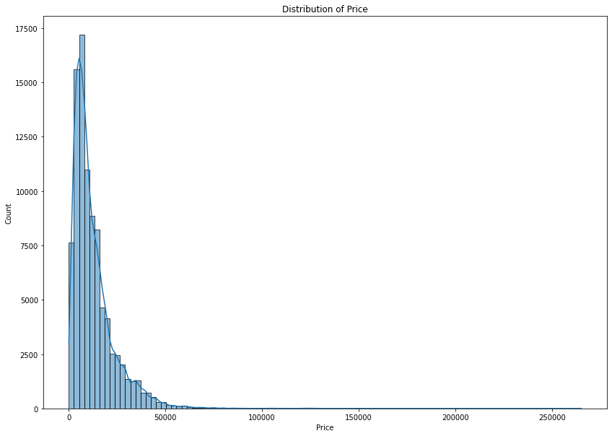
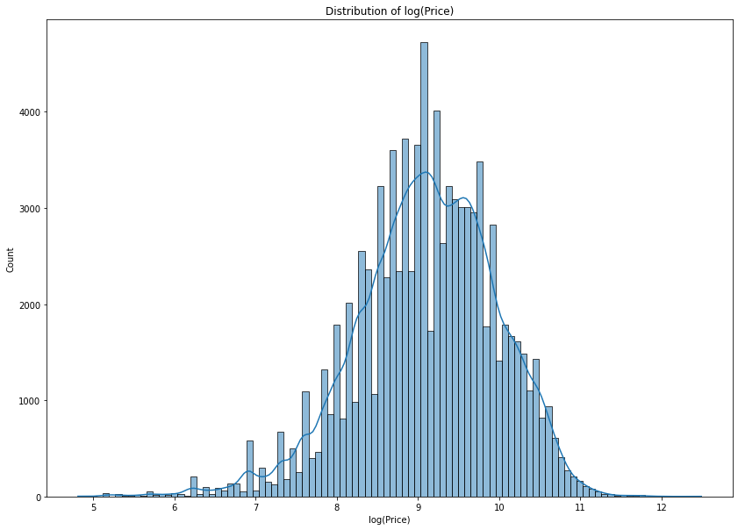
Linear Regression
Create k-1 dummy variables for each categorical variable with k-levels
Assess distribution of “price”: highly skewed right
Run regression on original data: R² = 0.399
Run regression on log(price): R² = 0.784

Slide 13
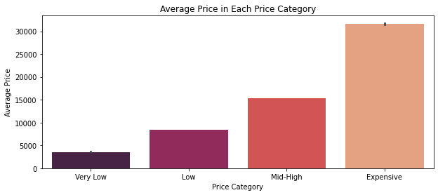
Bin “Price” for Classification Models
Divide Data into 4 equal bins based on 25th, 50th, and 75th percentiles
Very Low, Low, Mid-High, Expensive

Slide 14
Naïve Bayes
Build model using training set (67%) and a testing set (33%), as well as 10-fold cross validation
Accuracy: 45.12%
Using top 10 features using mutual information > 0.01:
Accuracy: 41.14%
Dropping features with low mutual information gain reduced model accuracy

Slide 15
Random Forest Classifier
Build model using training set (67%) and a testing set (33%), as well as 10-fold cross validation
Accuracy: 79.22%
Using top 10 features using mutual information > 0.01:
Accuracy: 71.06%
Like Naïve Bayes, dropping features with low mutual information gain reduced model accuracy

Slide 16
Results

Slide 17
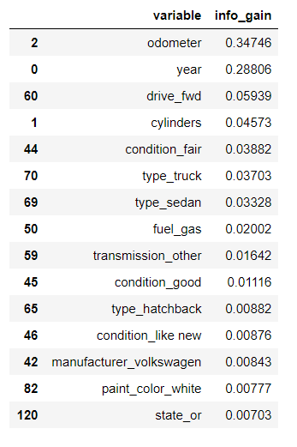
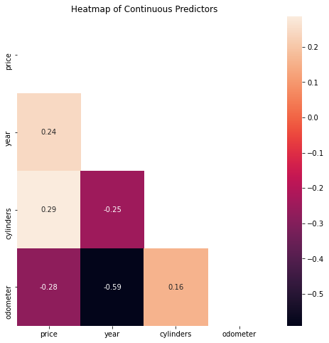
Important Features
“Odometer” and “year” have the most mutual information with “price”
Price is correlated with these two variables

Slide 18
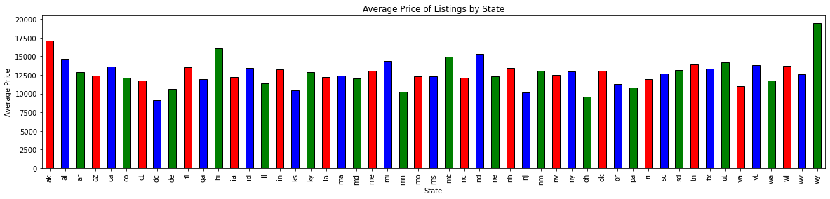
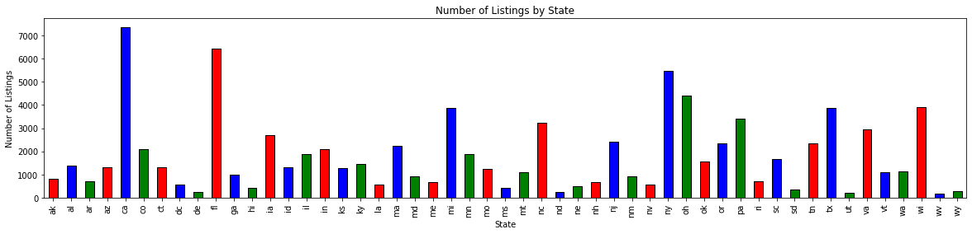
Interesting Insights
On average used cars are more expensive in Washington, Wyoming, Montana, Idaho, Utah, and Arkansas
Cars availability is very low in most of these states
Used cars are inexpensive in Washington DC, Pennsylvania, Virginia, Ohio, and Wisconsin
Aside from DC, these states have an average amount of used cars available for sale
California has a huge market for used cars, followed by Florida

Slide 19
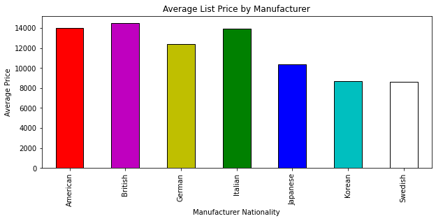
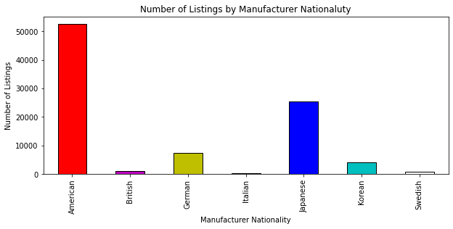
Interesting Insights, Cont.
57% American, 28% Japanese
Italian cars are very rare but some of the most expensive
British cars are also hard to find and are also pricey
Japanese cars have reasonable prices, and they are available in the used cars market
German cars seems to be a little more expensive than Japanese cars and a fewer number is available

Slide 20
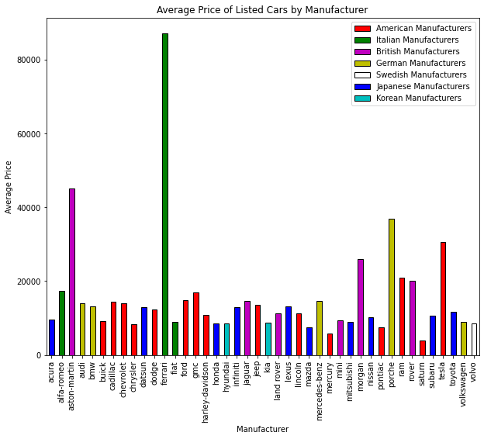
Interesting Insights, Cont.
Most expensive average listings: Ferrari
Followed by Aston-Martin and Porche
Average list price varies among American manufacturers
Japanese and Korean cars have lower mean listings

Slide 21
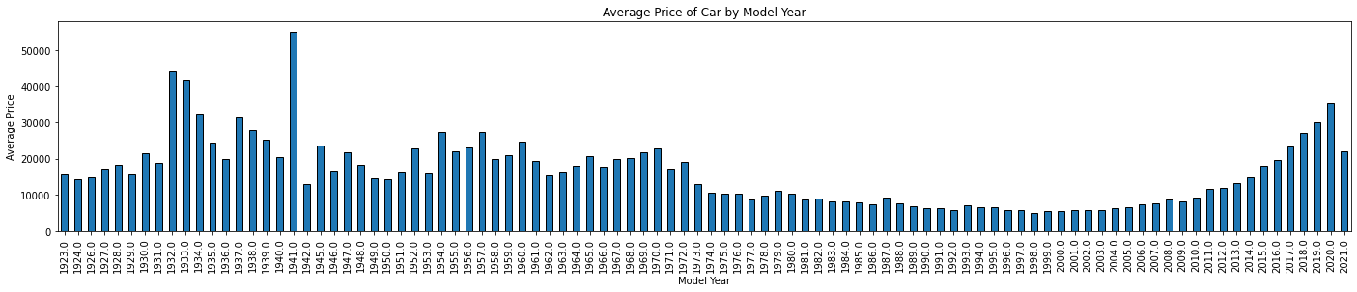
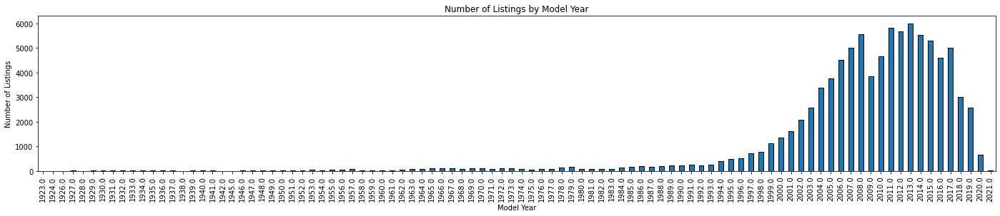
Interesting Insights, Cont.
Old cars are expensive and rare
Cars from 20-40 years ago have very low list prices, but higher list prices outside this range
Starting from 1998 prices started to increase as the model year becomes more recent

Slide 22
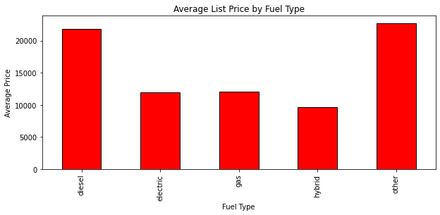
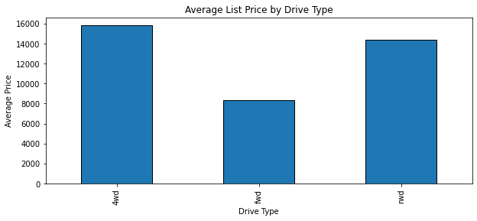
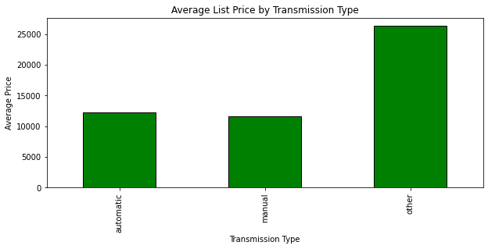
Interesting Insights, Cont.
Gas and hybrid cars are cheaper than other fuel types
Automatic and manual have similar average prices
Four-wheel drive and rear wheel drive cars have higher list prices than front wheel drive

Slide 23
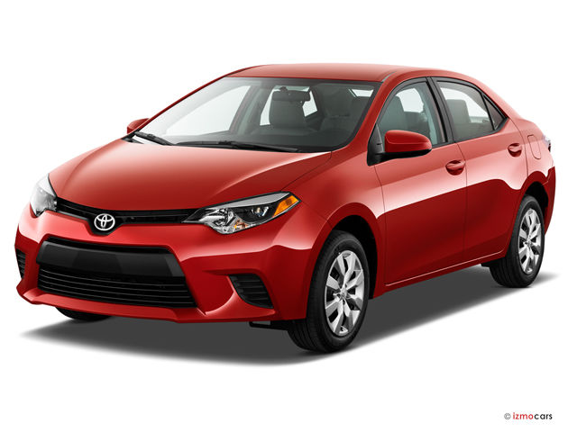
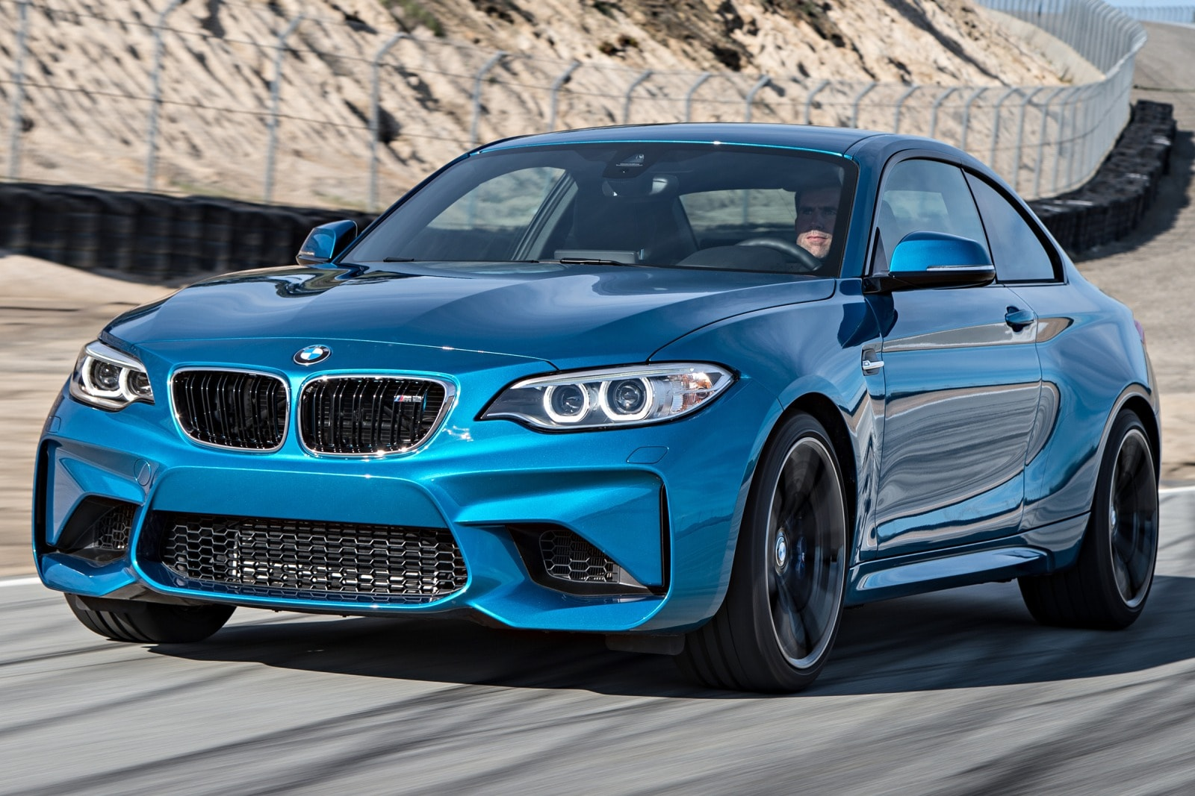
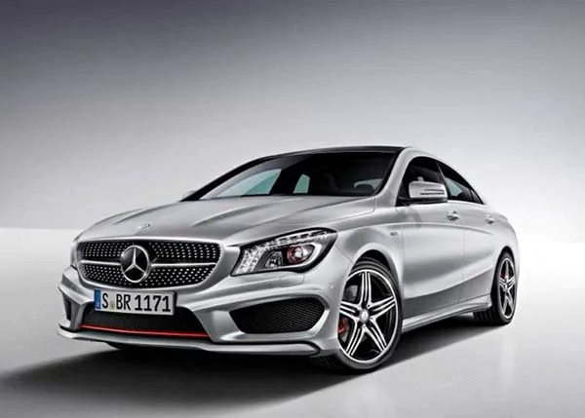
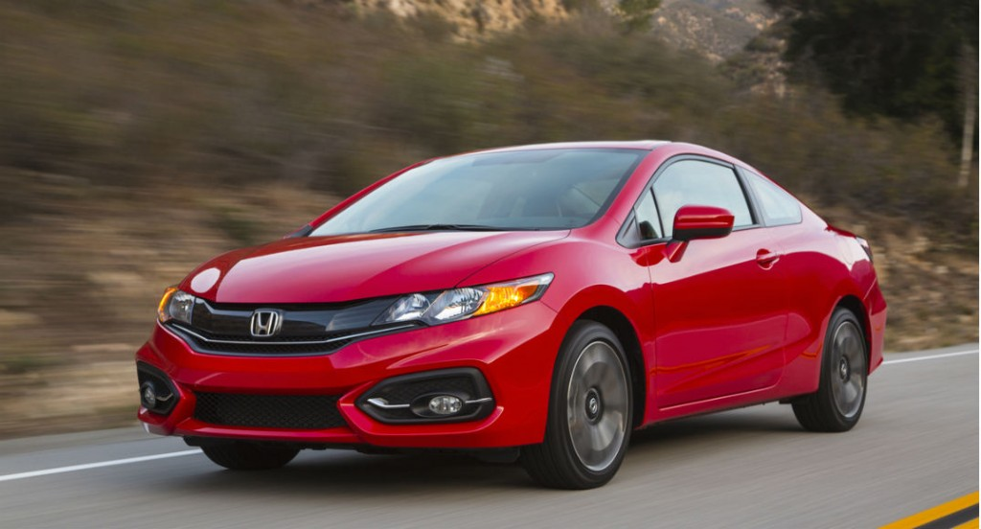
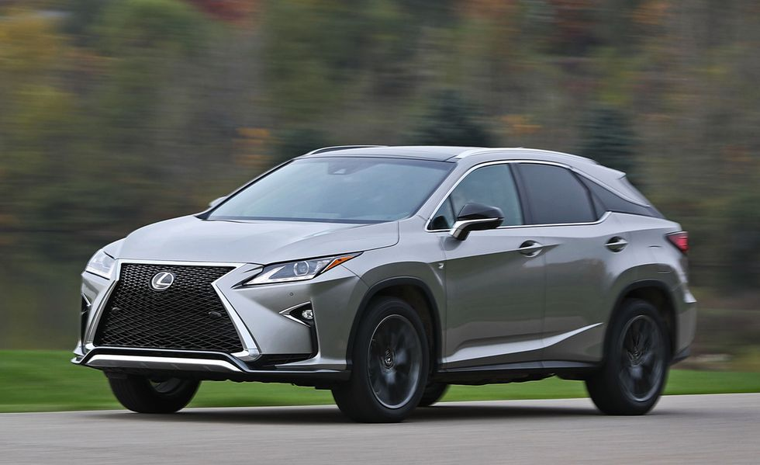
Results Summary
Buyers:
Gas or Hybrid
Japanese or German
“Excellent” or “As New” condition
Model year 2015-2017
Sold in California or Florida
Compare prices to similar cars sold in Pennsylvania, Virginia, Ohio, and Wisconsin
Low mileage
Listers: Give accurate information for all fields, lots of missing values bad for prediction
Random Forest good at predicting class
Linear Regression good at predicting log(list price)

Slide 24
Thank You For Your Attention!

